Slide 1

Bài 6: Networking, Socket
Giảng viên: Nguyễn Thành Trung
Email: Trungnt9@topica.edu.vn
‹#›

Slide 2
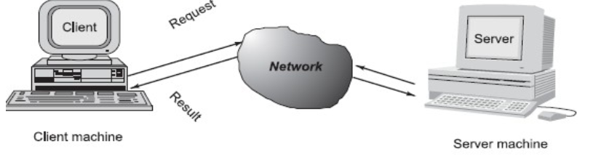

CLIENT/SERVER COMMUNICATION
At a basic level, network-based systems consist of a server , client , and a media for communication
A computer running a program that makes a request for services is called client machine.
A computer running a program that offers requested services from one or more clients is called server machine.
The media for communication can be wired or wireless network.
‹#›

Slide 3
CLIENT/SERVER COMMUNICATION
Generally, programs running on client machines make requests to a program running on a server machine. They involve networking services provided by the transport layer, which is part of the Internet software stack, often called TCP/IP (Transport Control Protocol/Internet Protocol)
The transport layer comprises two types of protocols,
TCP (Transport Control Protocol)  UDP (User Datagram Protocol).
The most widely used programming interfaces for these protocols are
“sockets”.
‹#›

Slide 4
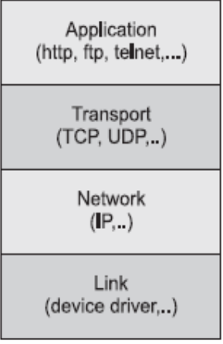
CLIENT/SERVER COMMUNICATION
TCP is a connection-oriented protocol that provides a reliable flow of data between two computers. Example applications that use such services are HTTP, FTP, and Telnet.
UDP is a protocol that sends independent packets of data, called “datagrams”, from one computer to another with no guarantees about arrival and sequencing. Example applications that use such services include Clock server and Ping.
The TCP and UDP protocols use “ports” to map incoming data to a particular process running on a computer.
Port is represented by a positive (16-bit) integer value
‹#›

Slide 5
CLIENT/SERVER COMMUNICATION
Some ports have been reserved to support common/well known services like ftp, http, https etc.
User-level process/services generally use port number value >= 1024.
Every computer on the Internet is identified by a unique, 4-byte IP address .
This is typically written in dotted quad format like 128.250.25.158 where each byte is an unsigned value between 0 and 255.
○ This representation is not user-friendly because it does not tell us anything about the content and then it is difficult to remember. Hence, IP addresses are mapped to names like www.google.com, which are easier to remember.
Domain name servers(DNS) translate these names to IP addresses.
‹#›

Slide 6
CLIENT/SERVER COMMUNICATION
Computers often need to communicate and provide more than one type of service or to talk to multiple hosts/computers at a time. For example, there may be multiple ftp sessions, web connections, and chat programs all running at the same time.
To distinguish these services, a concept of “port” s, a logical access point, represented by a 16-bit integer number is used.
That means, each service offered by a computer is uniquely identified by a port number.
Each Internet packet contains both the destination host address and the port number on that host to which the message/request has to be delivered.
The host computer dispatches the packets it receives to programs by looking at the port numbers specified within the packets.
‹#›

Slide 7
SOCKET
Sockets provide an interface for programming networks at the transport layer.
A server runs on a specific computer and has a socket that is bound to a specific port.
The server listens to the socket for a client to make a connection request
If everything goes well, the server accepts the connection.
Upon acceptance, the server gets a new socket bound to a different port. It needs a new socket (consequently a different port number) so that it can continue to listen to the original socket for connection requests while serving the connected client.
‹#›

Slide 8
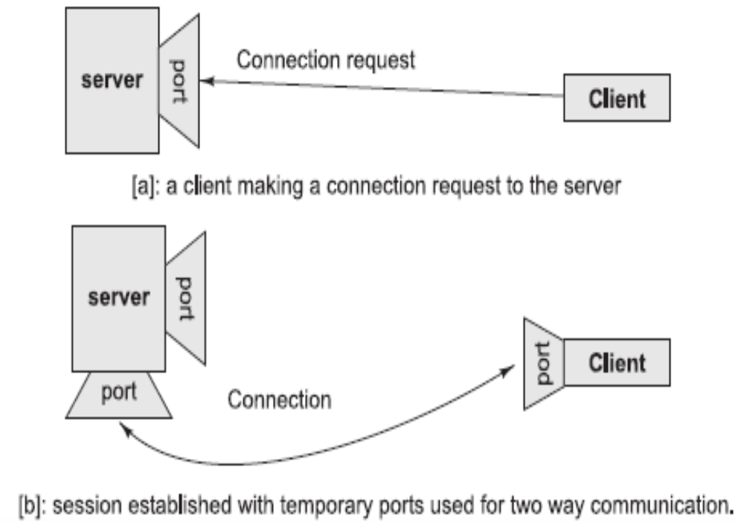
SOCKET
‹#›

Slide 9
SOCKET
Socket is bound to a port number so that the TCP layer can identify the application that data is destined to be sent.
Java provides a set of classes, defined in a package called java.net, to enable the rapid development of network applications.
The two key classes from the java.net package used in creation of server and client programs are:
ServerSocket
Socket
‹#›

Slide 10
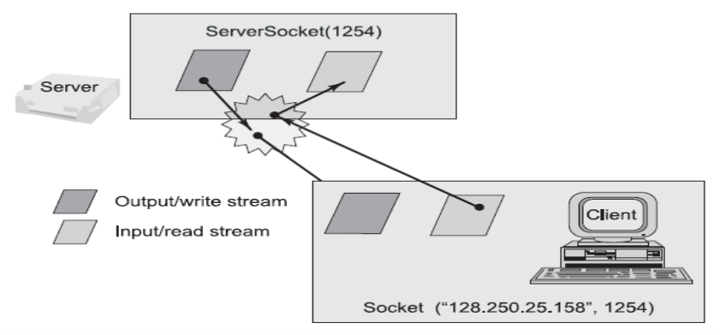
SOCKET PROGRAMMING USING TCP
A server program creates a specific type of socket that is used to listen for client requests (server socket), In the case of a connection request, the program creates a new socket through which it will exchange data with the client using input and output streams.
‹#›

Slide 11
STEPS TO CREATE SERVER PROGRAM
1. Open the Server Socket: ServerSocket server = new ServerSocket( PORT );
2. Wait for the Client Request: Socket client = server.accept();
3. Create I/O streams for communicating to the client
DataInputStream is = new DataInputStream(client.getInputStream());
DataOutputStream os = new DataOutputStream(client.getOutputStream());
4. Perform communication with client Receive from client: String line = is.readLine(); Send to client: os.writeBytes(“Hello\n”);
5. Close socket: client.close();
‹#›

Slide 12
STEPS TO CREATE CLIENT PROGRAM
1. Create a Socket Object: Socket client = new Socket(server, port_id);
2. Create I/O streams for communicating with the server.
is = new DataInputStream(client.getInputStream());
os = new DataOutputStream(client.getOutputStream());
3. Perform I/O or communication with the server: Receive data from the server: String line = is.readLine(); Send data to the server: os.writeBytes(“Hello\n”);
4. Close the socket when done: client.close();
‹#›

Slide 13
Internet addresses
Usually, you don't have to worry too much about Internet addresses—the numerical host addresses that consist of four bytes such as 132.163.4.102. However, you can use the InetAddress class if you need to convert between host names and Internet addresses.
The static getByName method returns an InetAddress object of a host.
For example, InetAddress address= InetAddress.getByName(“india.gov");
returns an InetAddress object that encapsulates the sequence of four bytes 132.163.4.102.
○ You can access the bytes with the getAddress method. byte[] addressBytes = address.getAddress();
‹#›

Slide 14
Internet addresses
Some host names with a lot of traffic correspond to multiple Internet addresses, to facilitate load balancing.
For example, at the time of this writing, the host name google.com corresponds to different Internet addresses. One of them is picked at random when the host is accessed. You can get all hosts with the getAllByName method.
InetAddress[] addresses =InetAddress.getAllByName(host);
Finally, you sometimes need the address of the local host. If you simply ask for the address of localhost, you always get the address 127.0.0.1, which isn't very useful. Instead, use the static getLocalHost method to get the address of your local host.
InetAddress address= InetAddress.getLocalHost();
‹#›

Slide 15
URL Connections
The URL and URLConnection classes encapsulate much of the complexity of retrieving information from a remote site.
URL url = new URL(urlString);
The Java 2 platform supports both HTTP and FTP resources.
If you simply want to fetch the contents of the resource, then you can use the openStream method of the URL class. This method yields an InputStream object. Using this stream object, you can easily read the contents of the resource.
InputStream uin = url.openStream(); BufferedReader in =
new BufferedReader(new InputStreamReader(uin)); String line;
while ((line = in.readLine()) != null) {
process line; }
‹#›

Slide 16
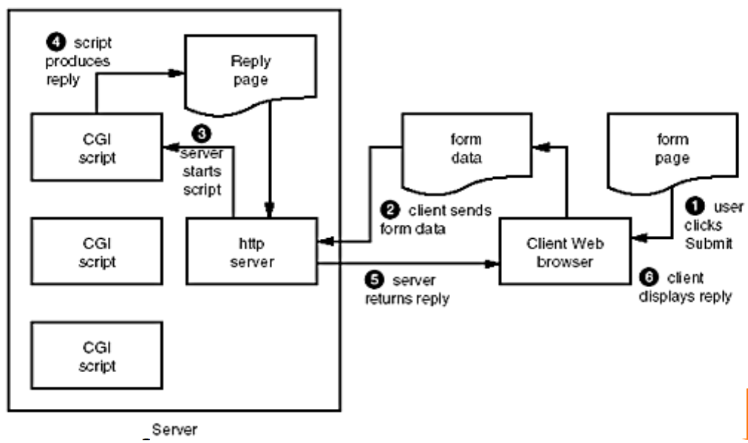
Posting Form Data
‹#›

Slide 17

‹#›

